Slide 1
Weekly meeting 17
Shengya Guo, CR/AVS3, 25.10.2024

Slide 2
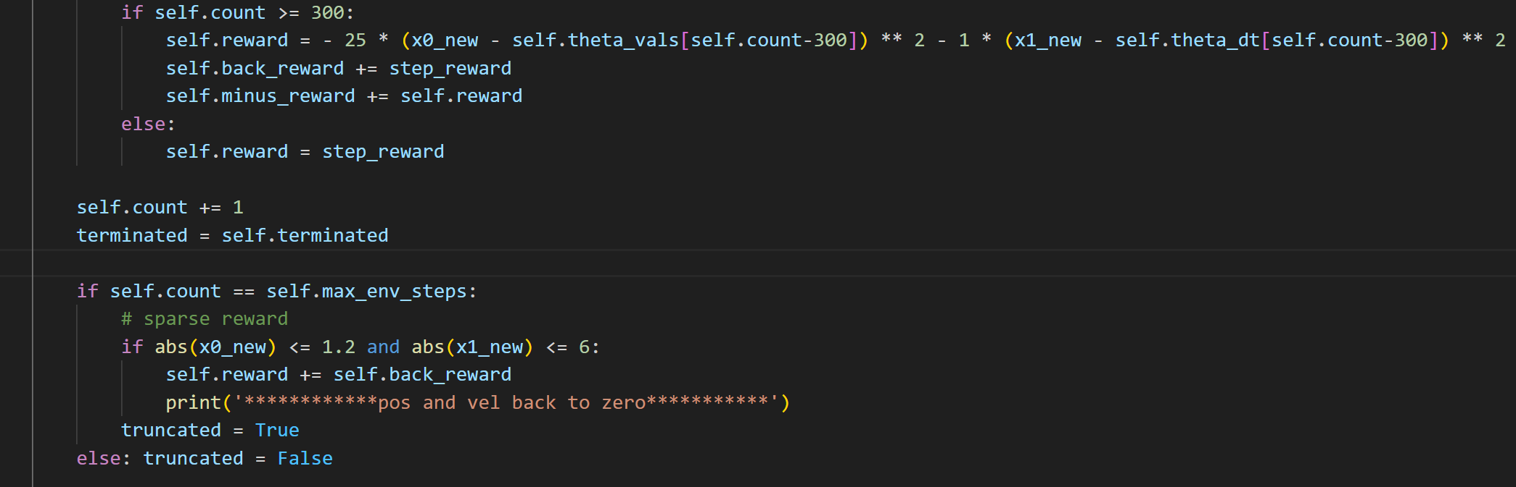
Two phase reward function
Reshape the reward function
First phase: 0 to 300ms, step reward based on FIM
Second phase: 300 to 500ms, step reward(minus) based on the trajectory which leads the motor back to the start point
Record the accumulating FIM step reward from 300ms to 500ms, if the motor successfully back to the start point with a tolerance in the end, add it to the episode reward

Slide 3
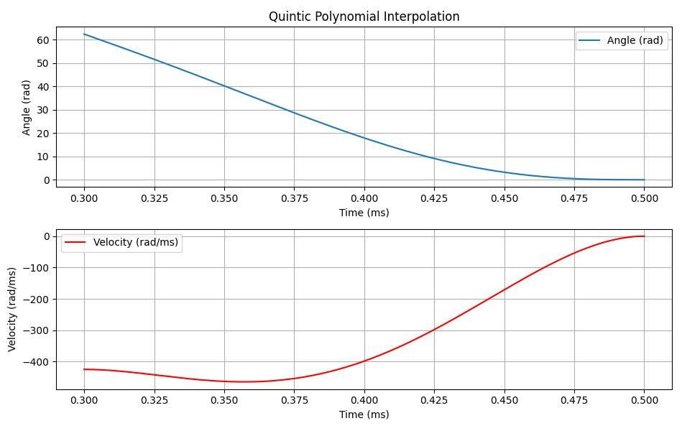
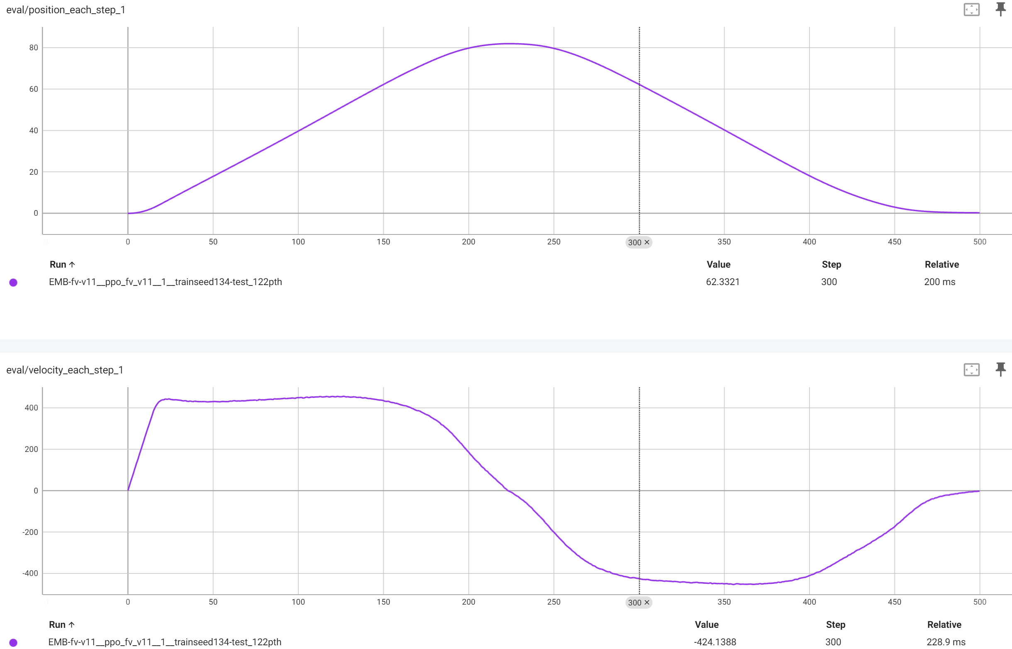
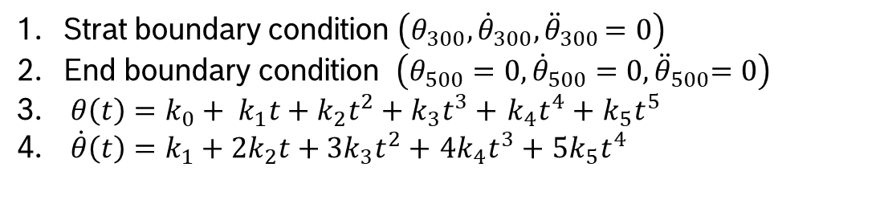
Quintic polynomial
Design of the reset trajectory
Strat boundary condition $\left(θ_{300}, {\dot{θ}}_{300}{, \ddot{θ}}_{300}=0\right)$
End boundary condition $\left(θ_{500}=0, {\dot{θ}}_{500}{=0, \ddot{θ}}_{500}=0\right)$
$θ\left(t\right)={{k_{0}+ k}_{1}t+k}_{2}t^{2}+k_{3}t^{3}+$ $k_{4}t^{4}+$ $k_{5}t^{5}$
$\dot{θ}\left(t\right)={k_{1}+2k}_{2}t+{3k}_{3}t^{2}+$ ${4k}_{4}t^{3}+$ ${5k}_{5}t^{4}$

Slide 4
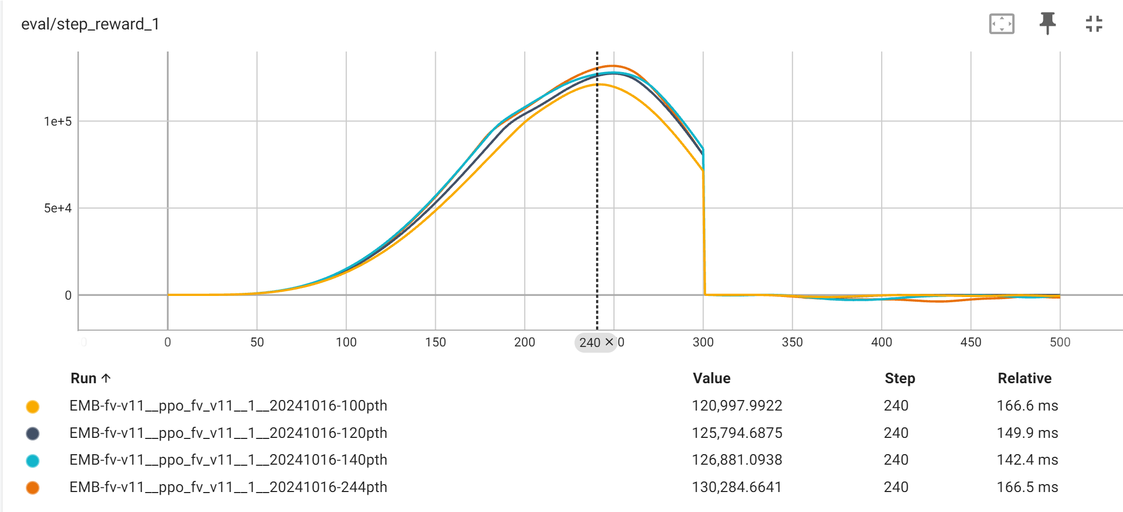
In first 300ms
Observation from 2M steps training
Model saved with checkpoint 20, 40, 60, …, 240, and 244
The agent focus on maxmail the reward in first 300steps

Slide 5
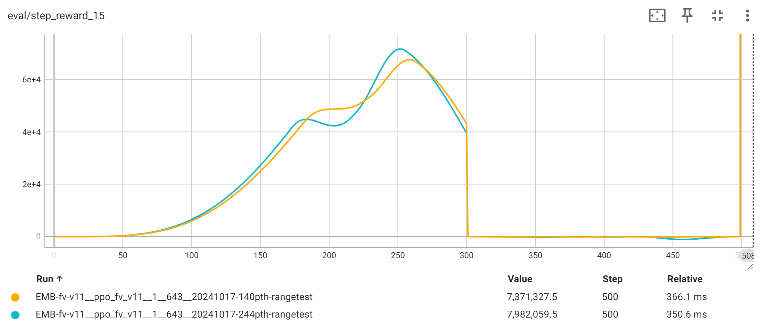
From 300ms to 500ms
Observation from 2M steps training
With the training going on, the agent take more risk in the last 300step, and won a higher onetime reward in the end

Slide 6
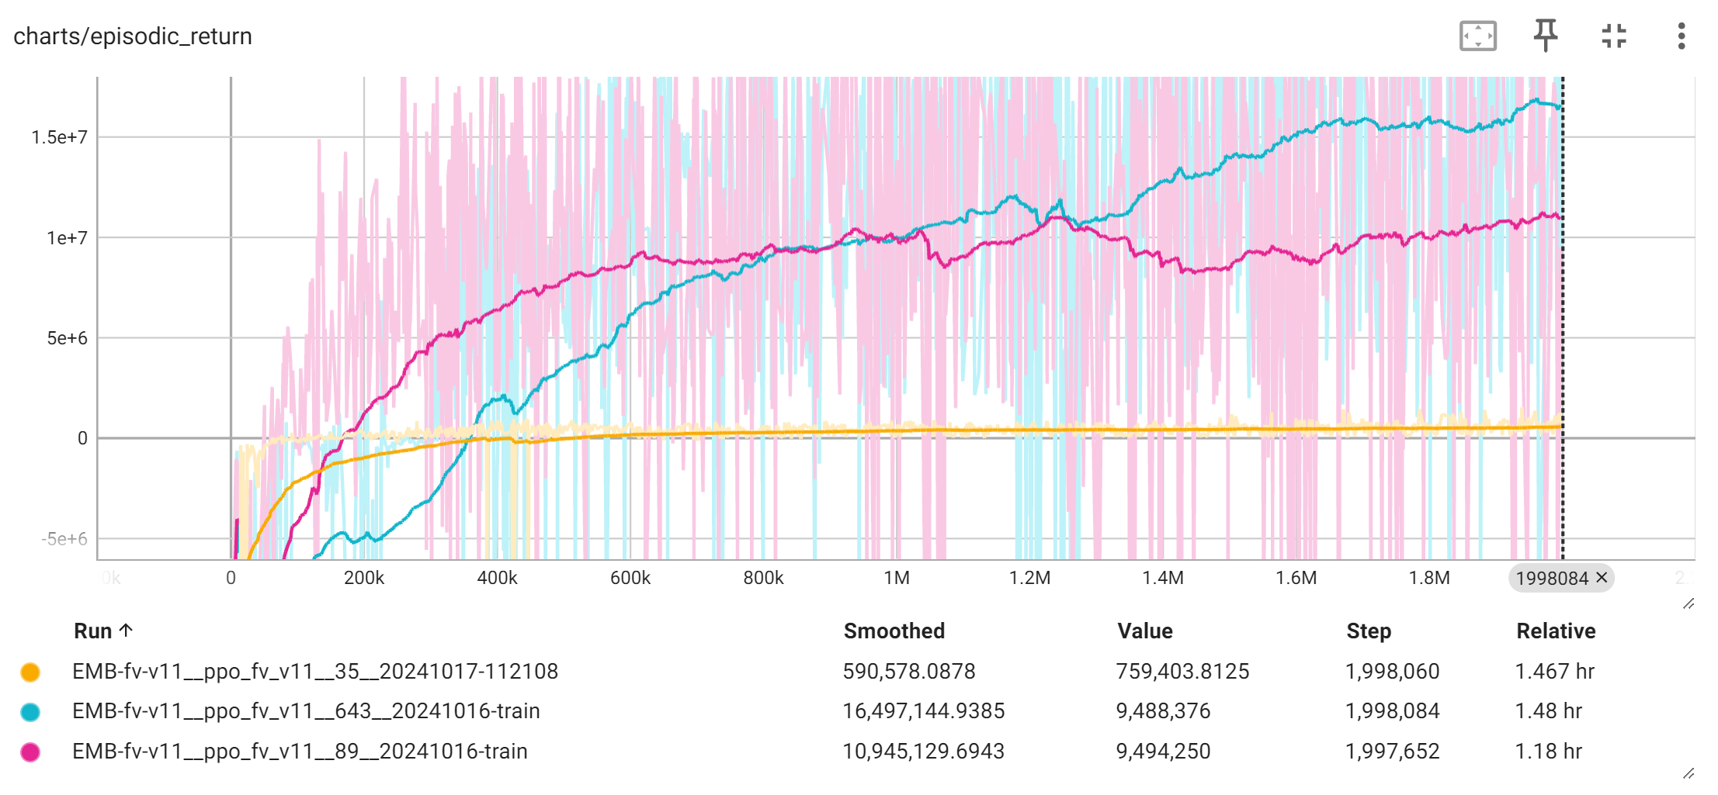
Stability of seeding
There is performance differences between seeds
4 different seed trained, 3 of them is good, 1 is not
The stability of seeding was improved by decreace the learning rate later

Slide 7
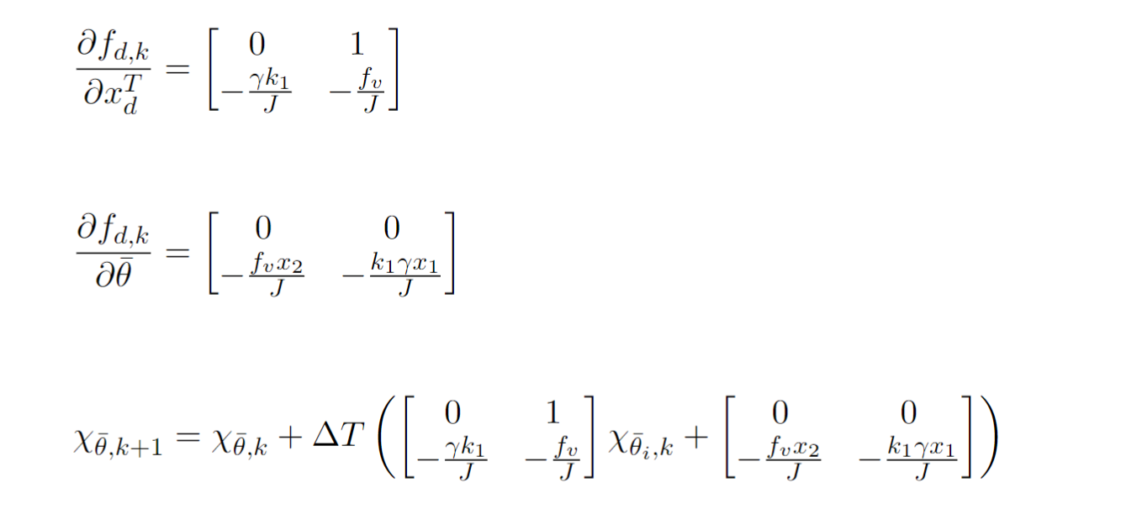
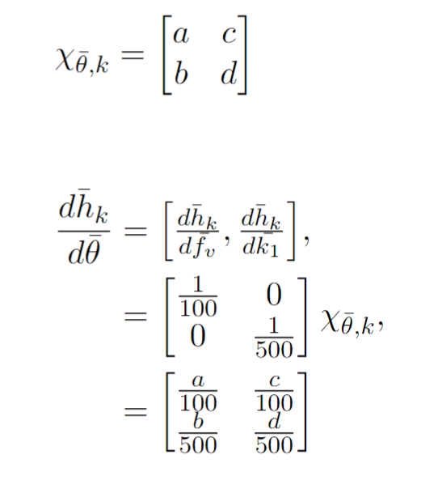
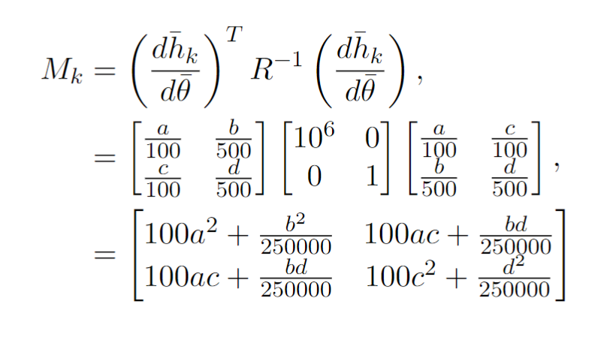
The caculation of FIM for two parameters
When velocity is higher, there is more information for the viscous friction parameter.
When position is higher, there is more information for the stiffness parameter.
Conclusion: To achieve higher information content, both high position and high velocity are needed simultaneously.
Consider a square wave as a good input for comparison.

Slide 8

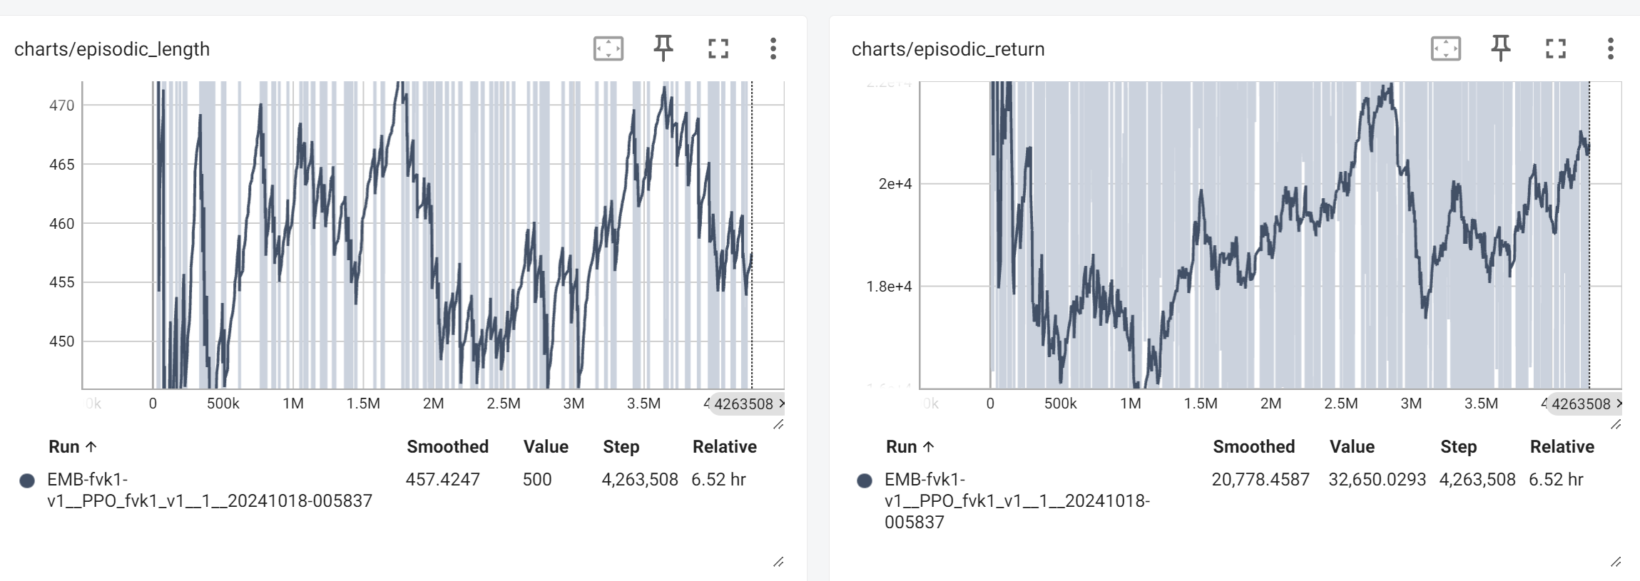
The reward function by two paramerts
The step reward changed
In the previous model, the step reared is small in beginning, but could reach 5e5 later
Now the logdet is used, and step reward is big in beginning, and small later
Also the value is smaller than 0.5
New parameters for the reward function needed

Slide 9
Reward function shaping 1
Two Parameters Excitation
Consider of the differences between the log() function will be very small, rather than use the original function, a parameter to amplify the difference was chosen.

Slide 10
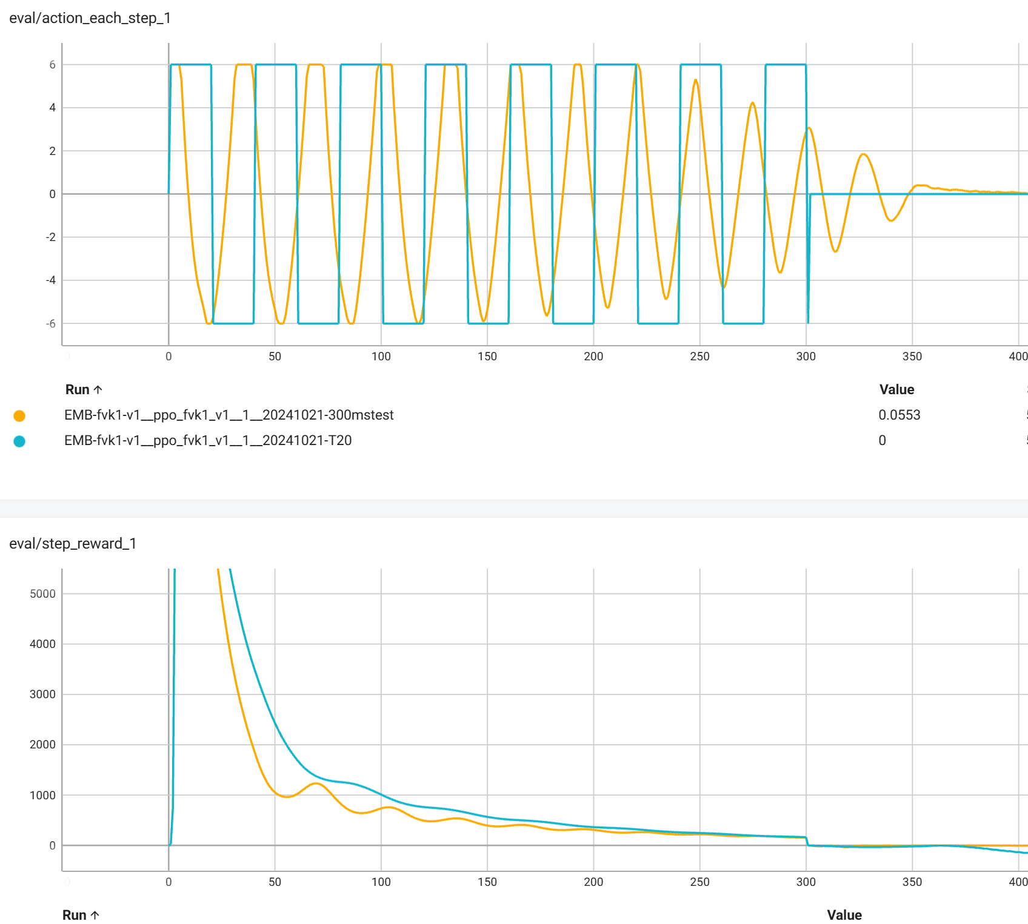
Reward function shaping 1: Reseult
Two Parameters Excitation
$$α=1e^{4}$$

Slide 11
Reward function shaping 2
Two Parameters Excitation
Consider of the differences between the log() function will be very small, rather than use the original function, a parameter to amplify the difference was chosen.

Slide 12
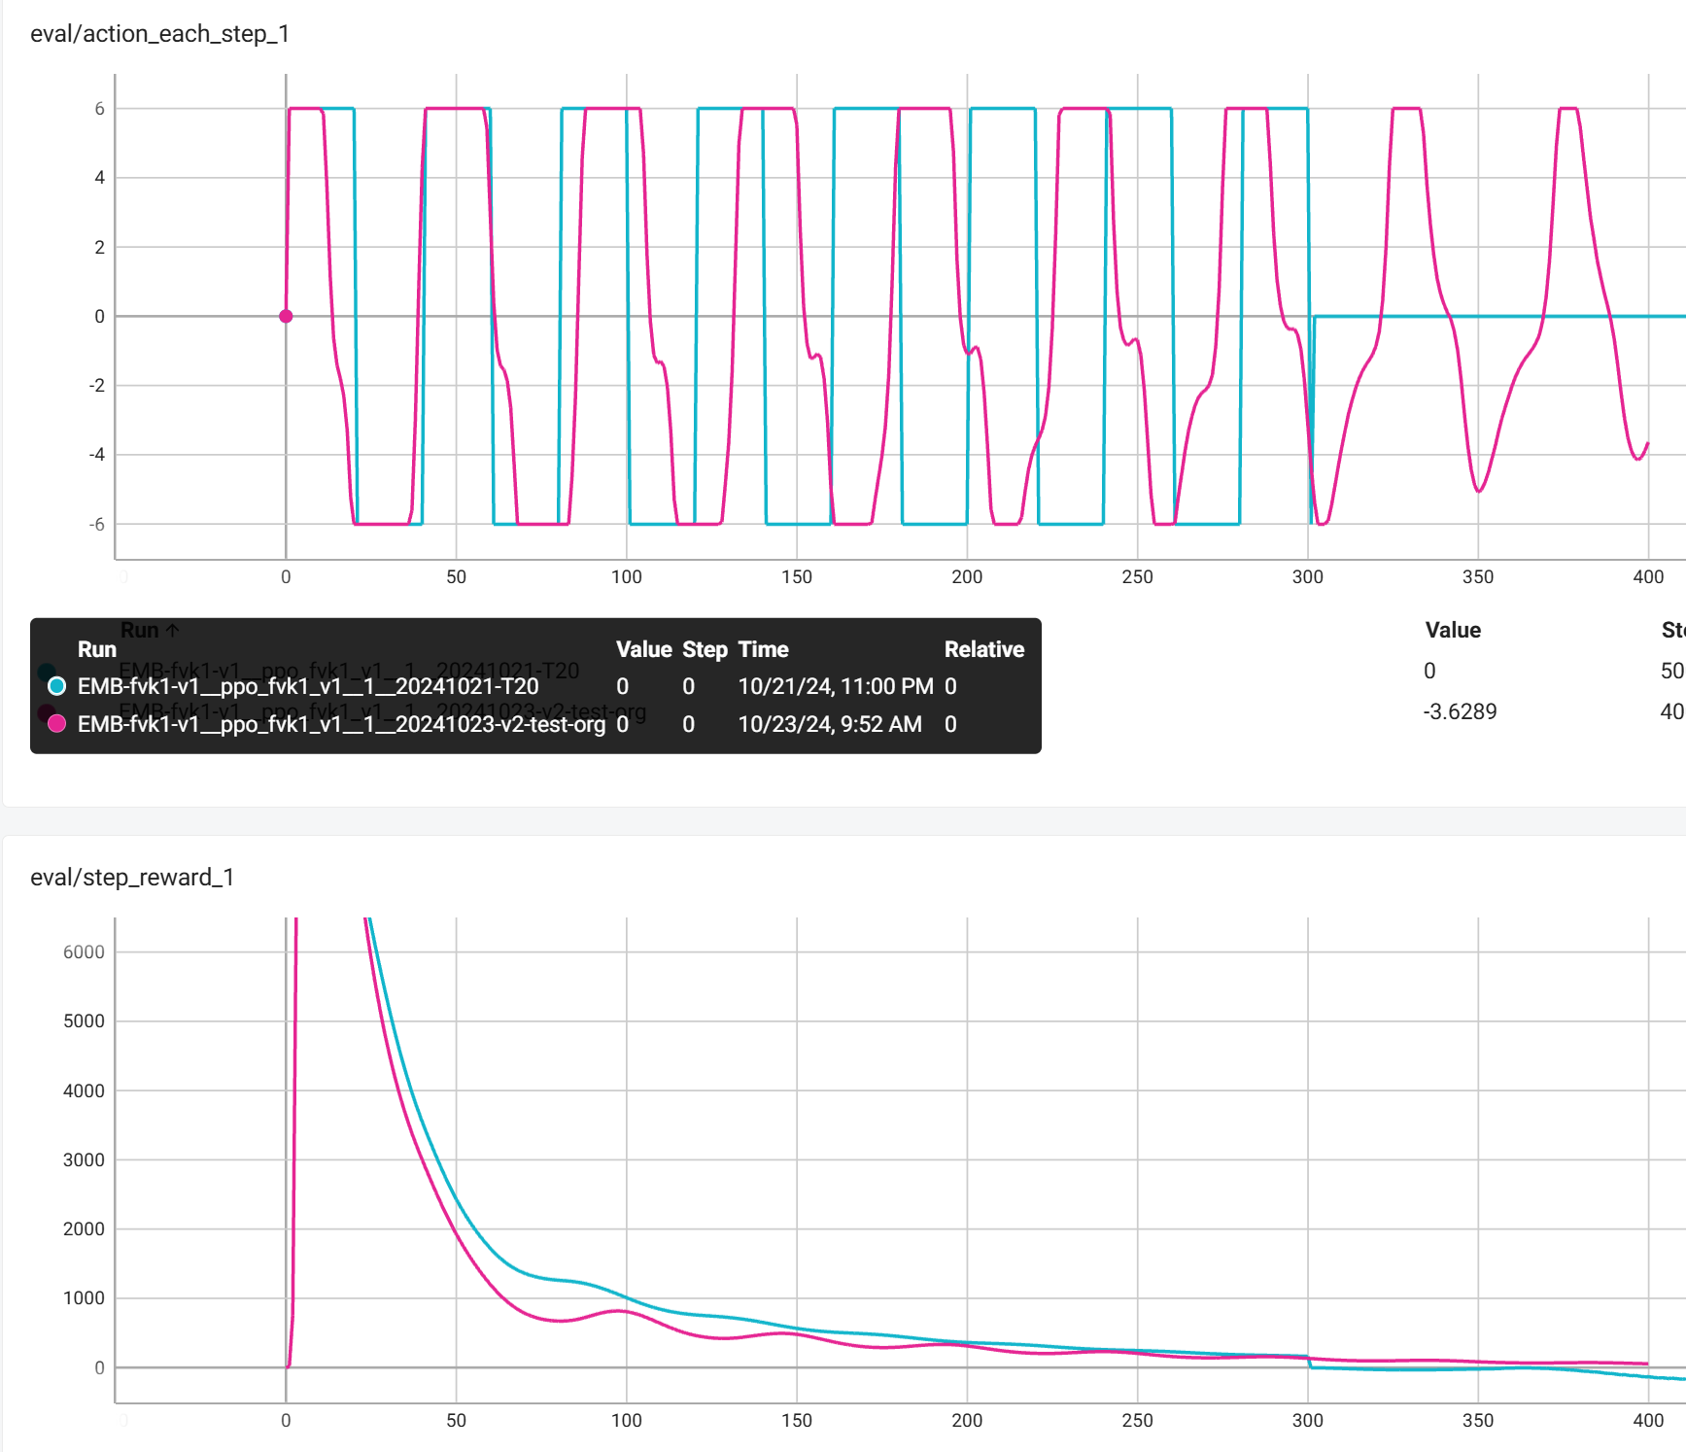
Reward function shaping 2: Reseult
Two Parameters Excitation
$$α=1e^{4}, β=2$$

Slide 13
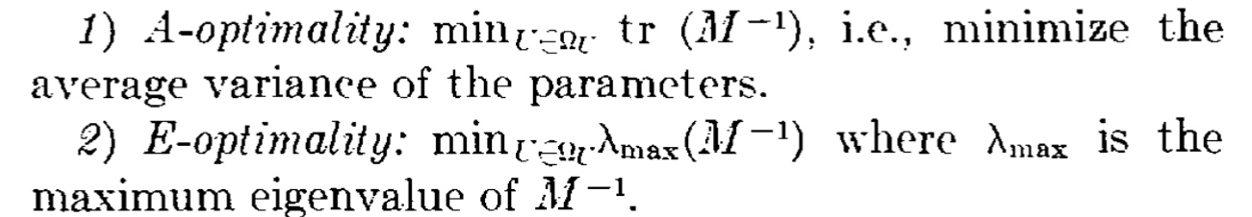
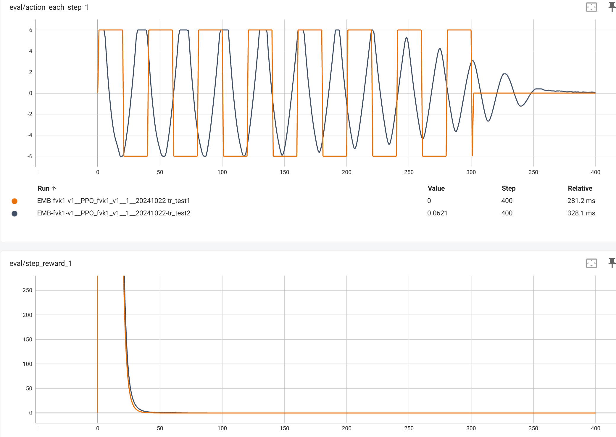
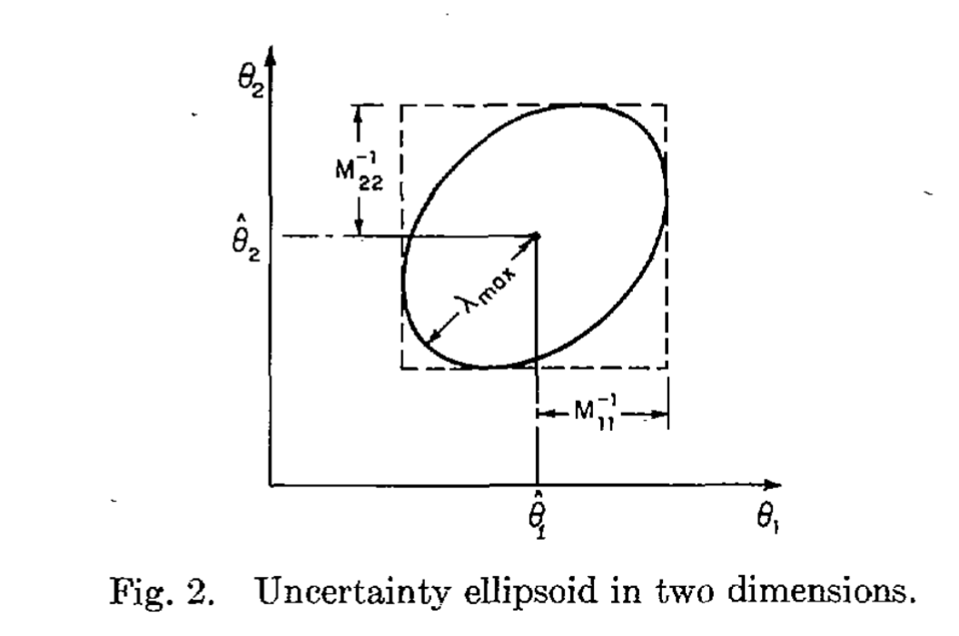
Reward function: A-optimality
Two Parameters Excitation
Consider of using A-optimality criterium.
But even smaller difference

Slide 14
D-optimality
Two Parameters Excitation
To be done

